Slide 1
PRINCIPLES OF EFFECTIVE INFORMATION MANAGEMENT AND MANAGING UPWARDS
Induction course for the newly promoted officers to the post of Under Secretaries.
Dr. Patrick Ibembe
SPECIAL PRESIDENTIAL ASSISTANT
07th /March/2019

Slide 2
Introduction.
  Justification of the Training
  Definition of terms : Information management, Managing Upwards .
Order of Precedence of Government of Uganda.
Managing upwards as an under secretary
Types of People to manage up (Bosses)
Statistics on managing up
43% people leave jobs = Boss
30% of Bosses end up well
33% turn over,
8% of bosses plan
65% ,58% 70%

Slide 3
Issues to note for effective managing upwards:
Accepting the subordinate role
VIPs and Observation decks
Stage setting function (Follow up in areas)
Palace politics (Locus of power)
Bridges and gate keepers
Palaces and their animals
Cultural fit
Familiarity with cultures.

Slide 4
ATTRIBUTES FOR MANAGING UPWARDS
Making sacrifices for the Boss (One above you)
Pleasing the Boss
Planning, Diary tracking, Time Management scoping functions.
The multi skilled detail
Being principled
Ethics (Corruption)
Ability to command respect.

Slide 5
Attributes…………..
Legal and Regulatory framework
Balancing time and quality
Handling urgent/ important assignments
Emotional intelligence
Creativity
Appreciation of close protection principles practices
Delegating effectively
Managing meetings/events

Slide 6
THE UNIQUE SKILLS YOU SHOULD POSSESS :
Branding
Information
Customer care
Net works
Negotiation skills
Effective communication

Slide 7
SOCIAL GRACES BY UNDER SECRETARIES:
Skills needed to handle social situations in life (How do you carry yours self)
Manners, refinement, poise, Composite, style.

Slide 8
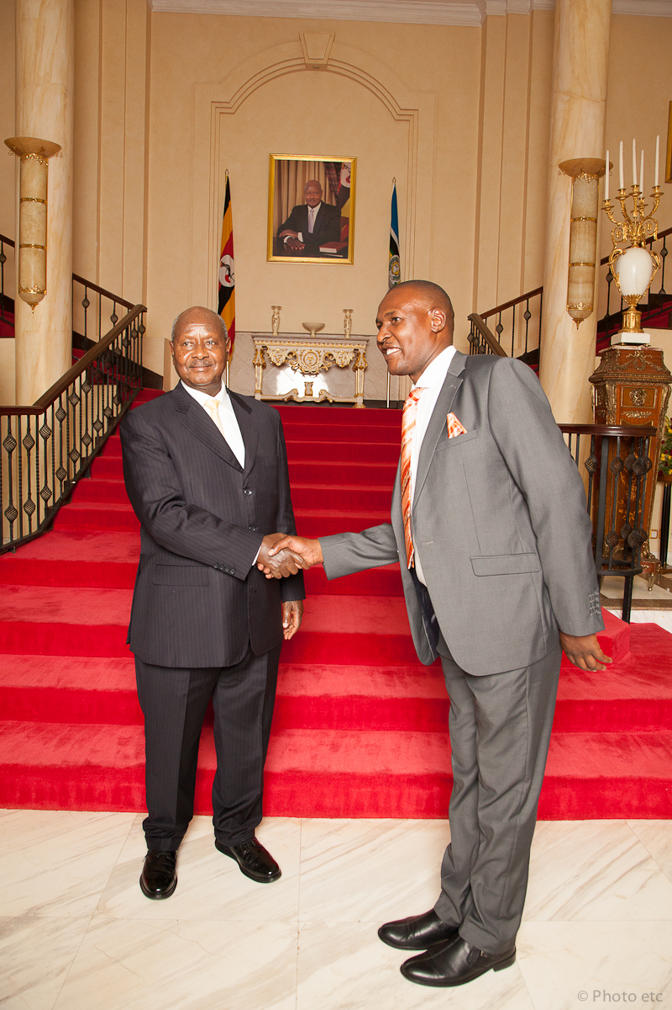
President Museveni congratulates the Facilitator upon having successfully managed a function at State House Entebbe

Slide 9
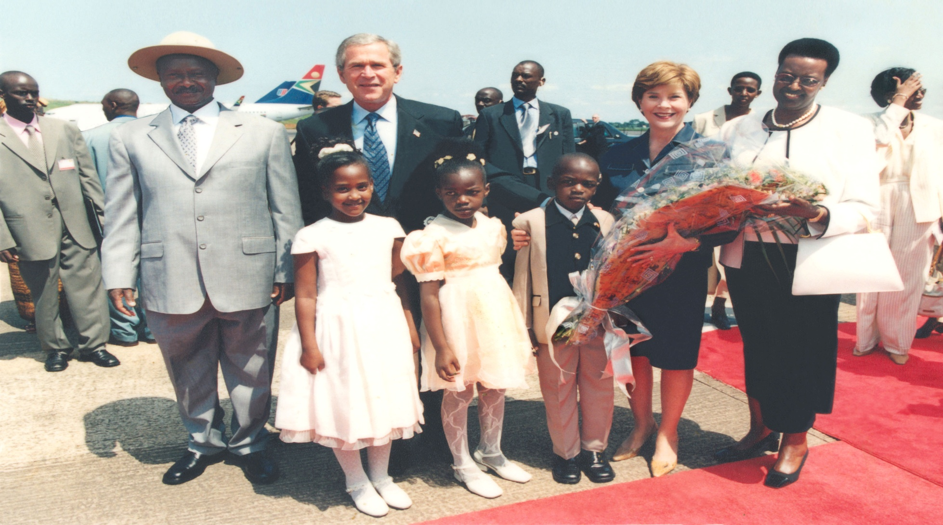
State visit of President Bush of America. L-R : President Yoweri K Museveni, President Bush, Mrs Laura Bush, Mrs Janet K Museveni. In the Middle of the front row is Anthea Ibembe, daughter to the Facilitator (Facilitator is in deep background)

Slide 10
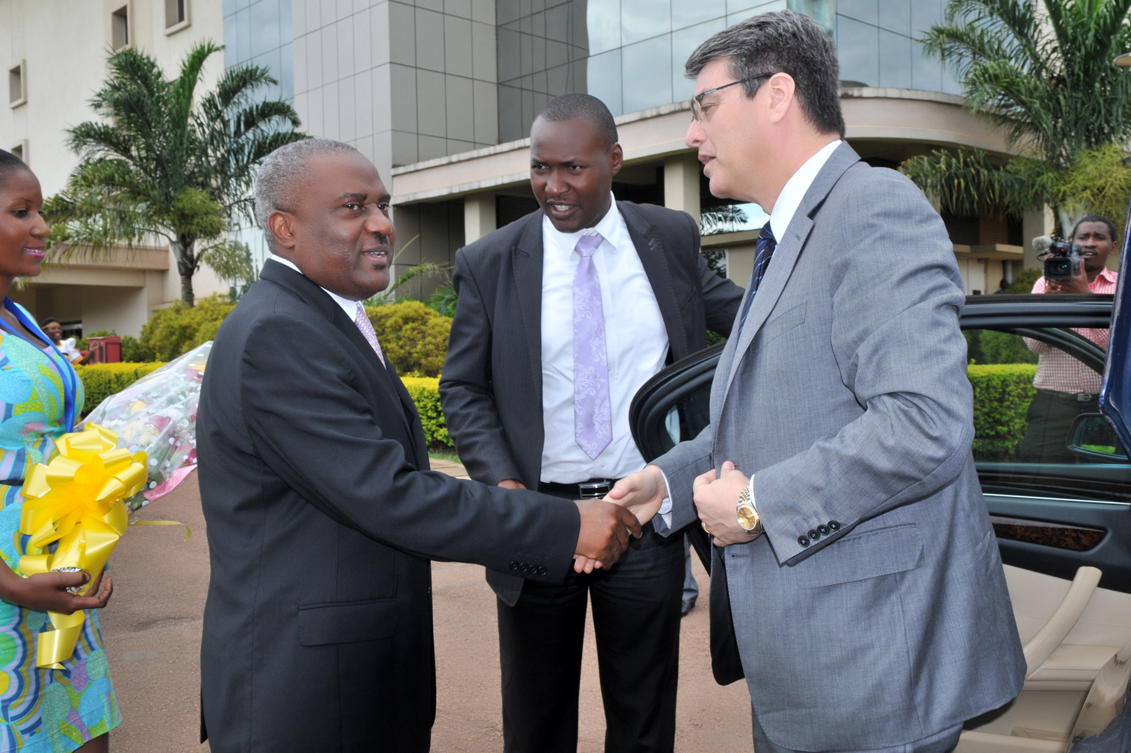
The facilitator introducing the Chairman of Quality Chemicals Industries to H.E Roberto Azavedo, the Head of World Trade Organization (WTO). In a typical protocol setting, you introduce a junior person to a senior(The facilitator managed many such high profile visits)

Slide 11
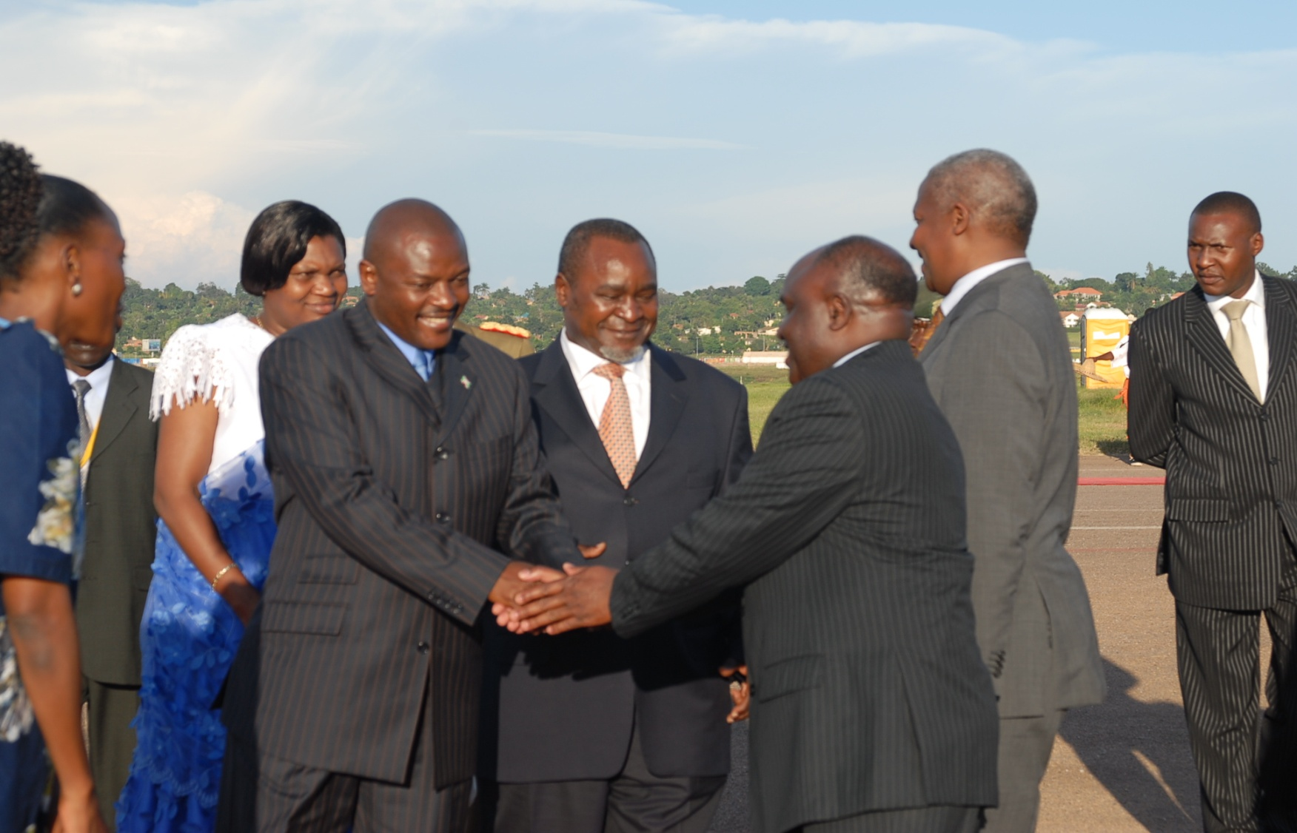
Managing departure ceremonies of visiting Burundi President H.E Pierre Nkuruziza . On the extreme left(black stripped suit in the facilitator)

Slide 12
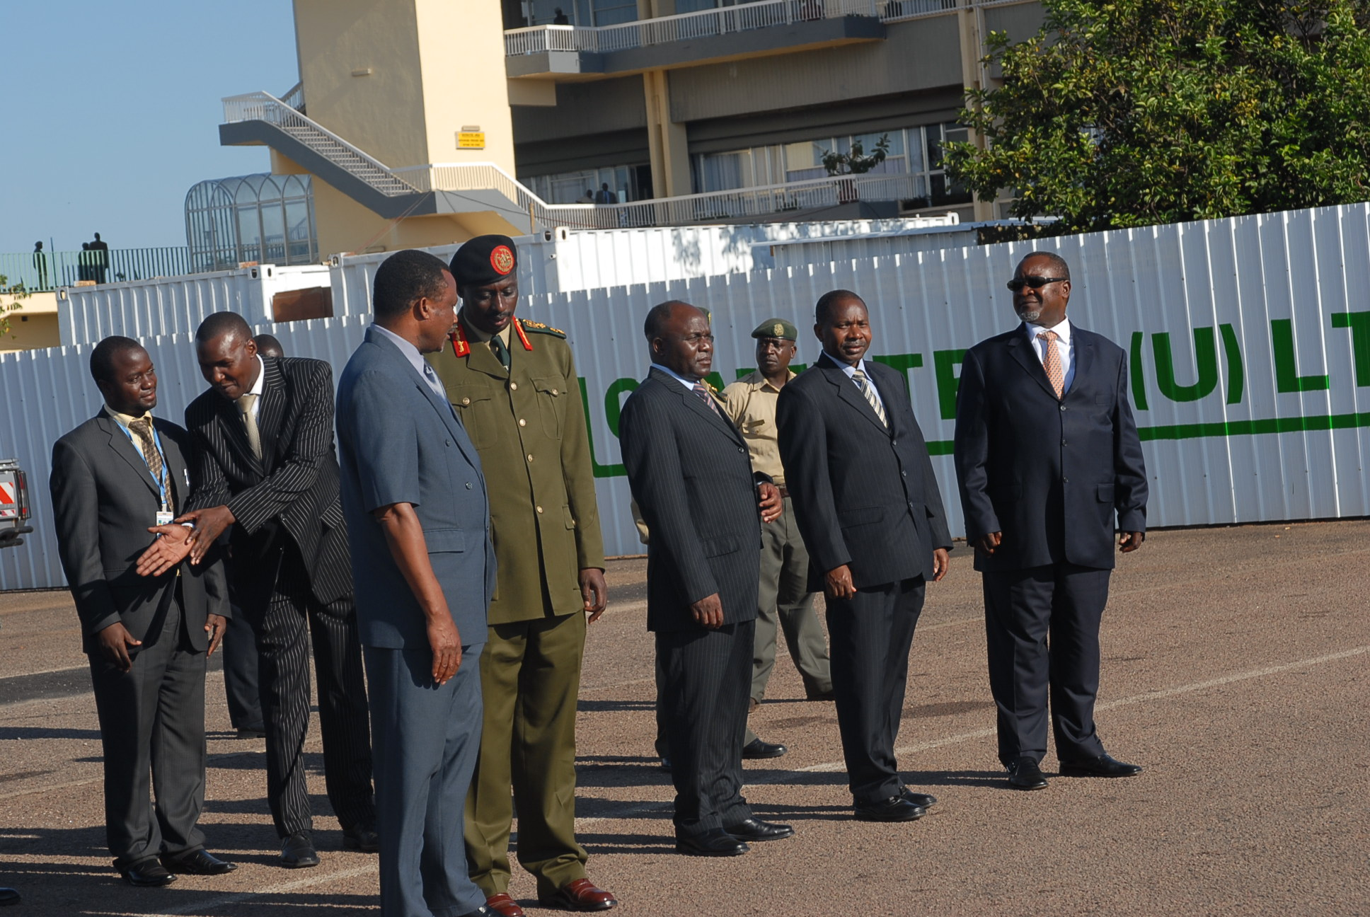
Preparing to receive a visiting Head of State –the facilitator shares an instruction with Mr. Habib Miggade , a Foreign Service Officer.

Slide 13
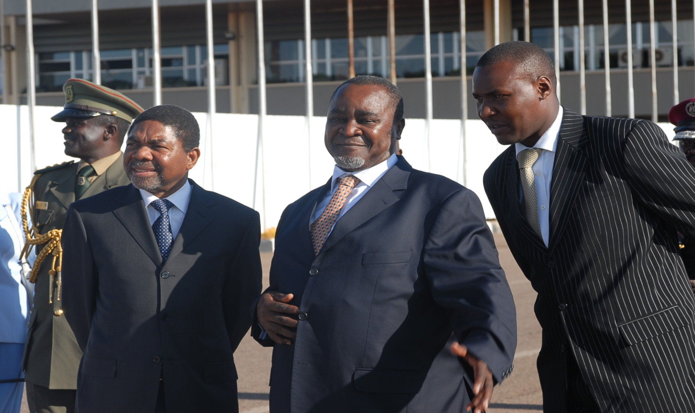
L-R: Zamzibar President Dr. Ali Mohamed Shein , Vice President Gilbert Bukenya and the facilitator at an official function. The facilitator(far right) listens attentively.

Slide 14
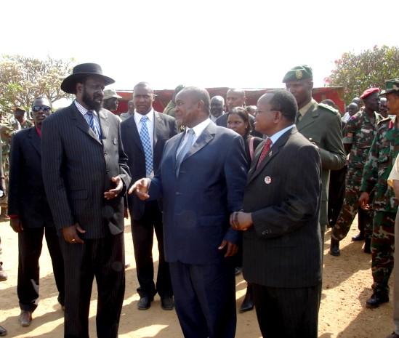
The facilitator standing between President Salvar Kirr and Vice President Bukenya at a national function in Juba South Sudan.

Slide 15
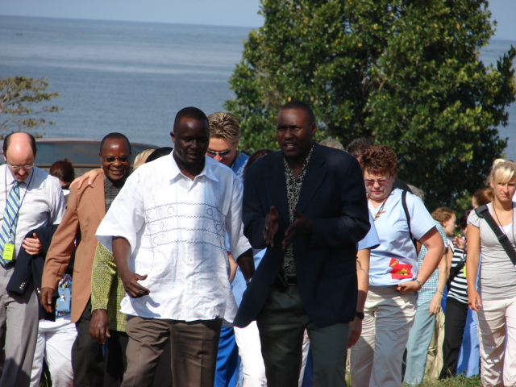
Managing affairs of high calibre investors for USA: facilitator, front from the right, leads investors on a tour.
Notes:
.

Slide 16
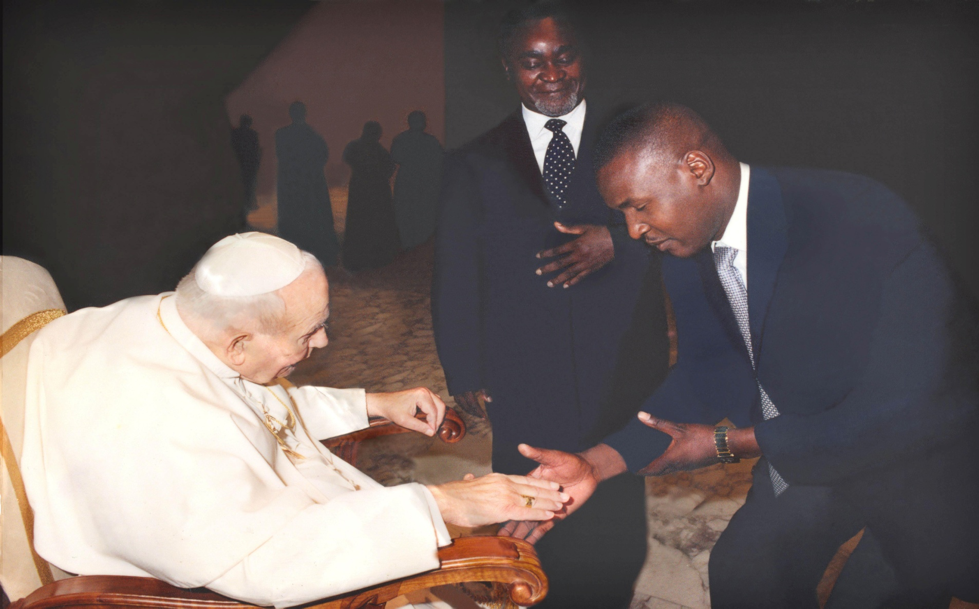
Vice President Bukenya introduces the facilitator to the Pope at a function in the Vatican. In VIP management, a personal Assistant cannot introduce a Vice President to the Pope, it is the other way round.

Slide 17
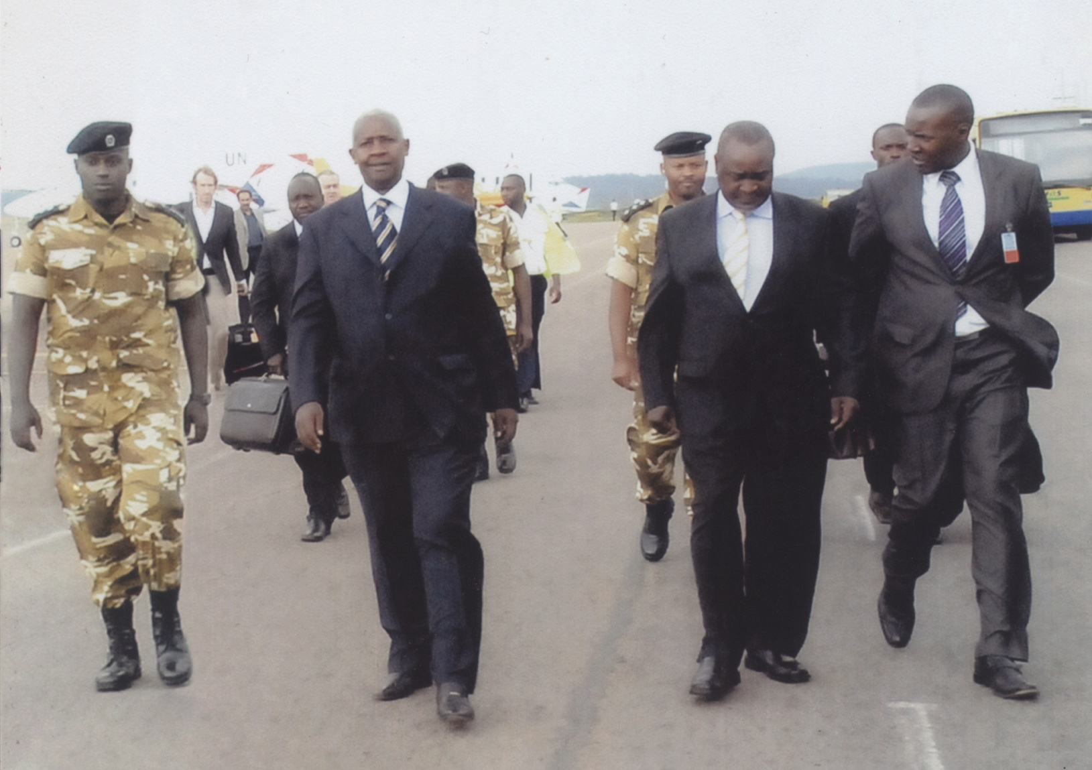
L-R : H.E Sam Kutesa (President UN Assembly) H.E Prof G Bukenya and facilitator briefing the Vice President on arrival from a UN Conference in New York.

Slide 18
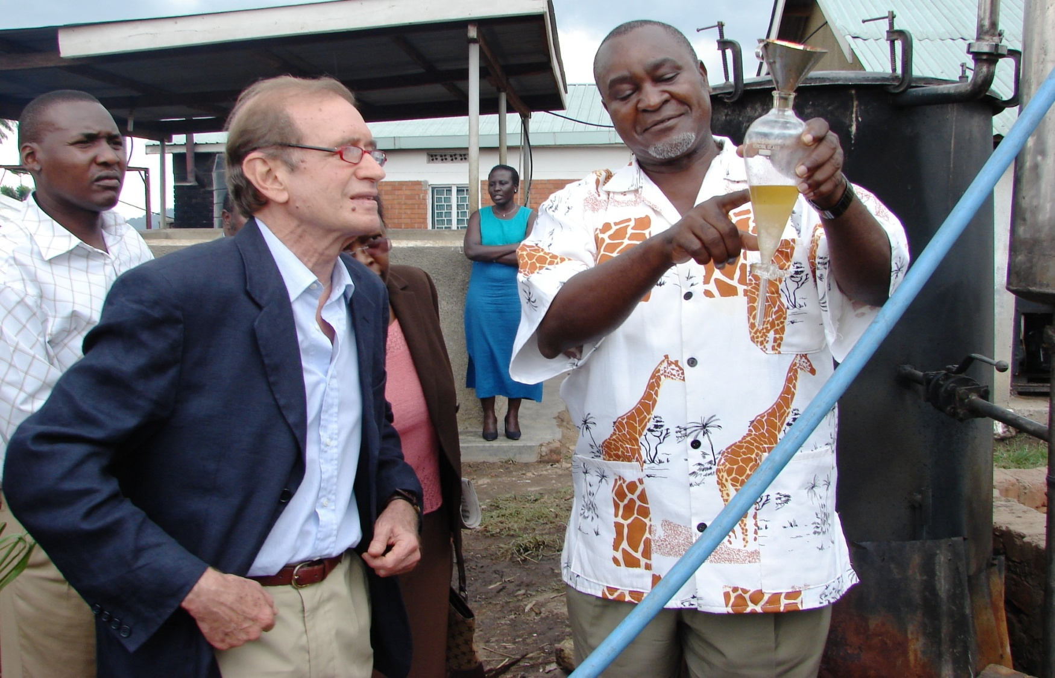
The facilitator listens attentively as Vice President Prof Bukenya explains a social entrepreneurial project to the Italian Ambassador to Uganda . The facilitator implemented many projects in related fields.(In deep background is Aisha Magezi Kalule , Protocol Officer)

Slide 19
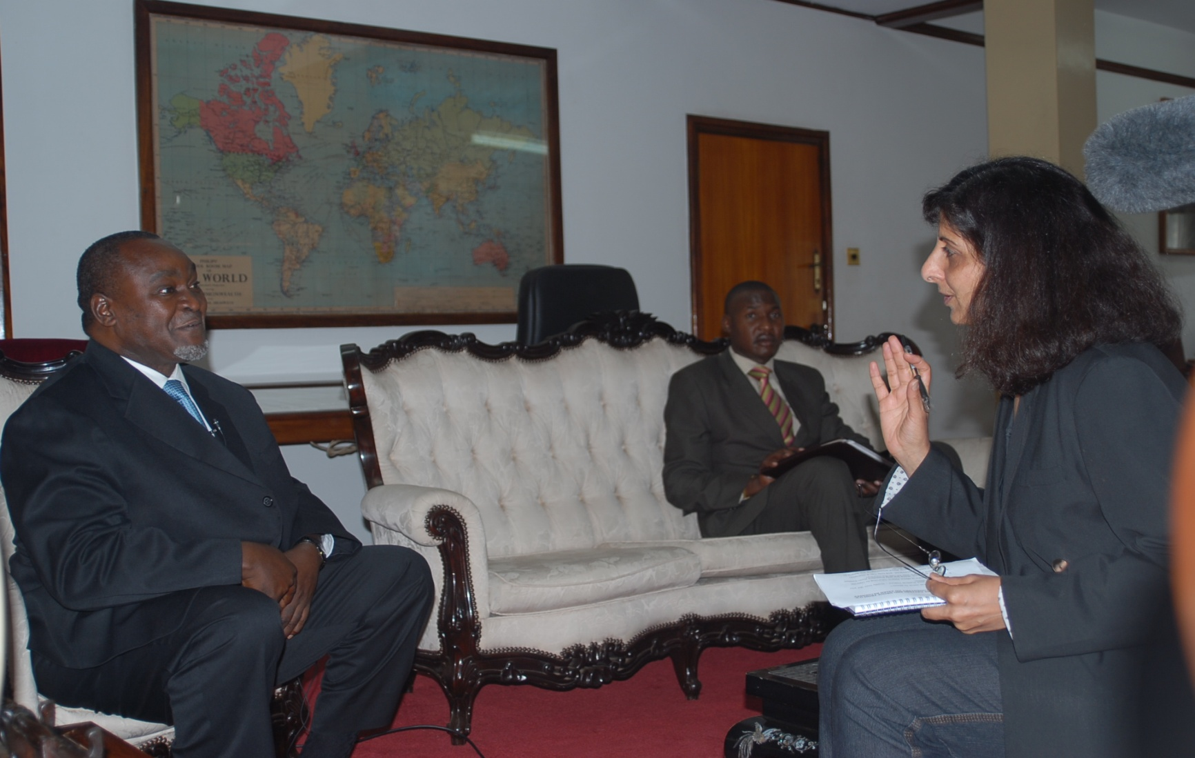
Thank you for listening

